Slide 1
CSCI 331 – Group Project 1
Members: Timothy Dakis (Group Leader), Mikhaiel Gomes, Shivanie Kemraj, Konrad Rakowski, Kevin Tang

Slide 2
Project Management
This section of the presentation will show aspects of project management, it will include:
The project plan
Screenshots of all meeting notes
Briefly speak of how the group assisted eachother
Screenshots of all to-do lists by member
Screenshot of Gannt chart

Slide 3
The Project Plan
Get the JDBC done
Do the queries
Determine which queries would be the Top 3 “best” and “worst” per individual, and then from those pick the Top 3 “best” and “worst” for the group
Correct the “worst” queries
Make the PowerPoint
Add queries (grouped by individual)
Add outputs (SSMS/Azure output, JSON output, and JDBC output)
Add remaining diagrams for each
Add project management details
Record

Slide 4
Meeting Details, Discord, and how the Group Assisted Each other
Only held one meeting throughout the project

Slide 5
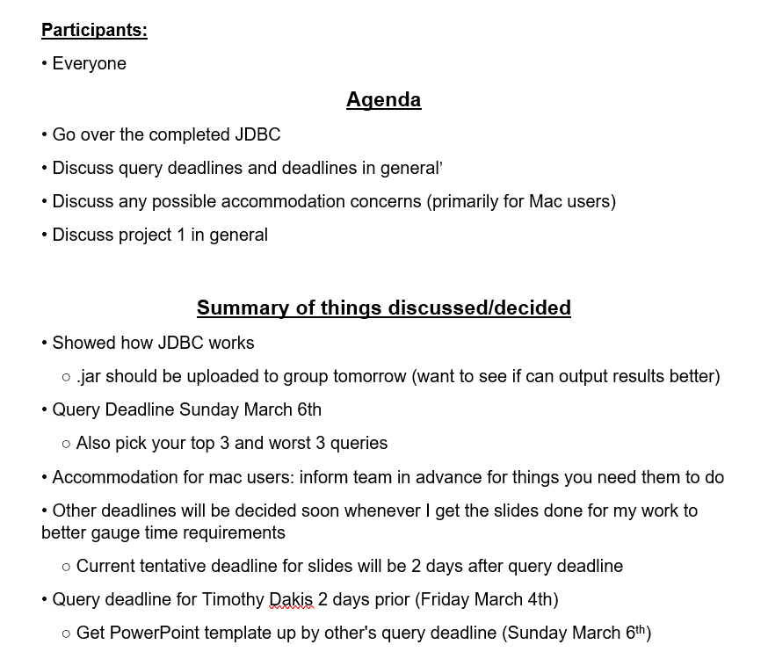
March 1st 2022 Meeting Summary

Slide 6
In Lieu of Regularly Scheduled Meetings…
We utilized Discord to organize and manage parts of the project and deadlines

Slide 7
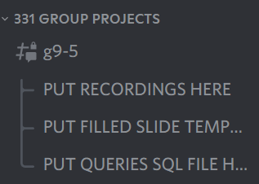
Example: to ensure everyone’s work is submitted, threads were used to compile results

Slide 8
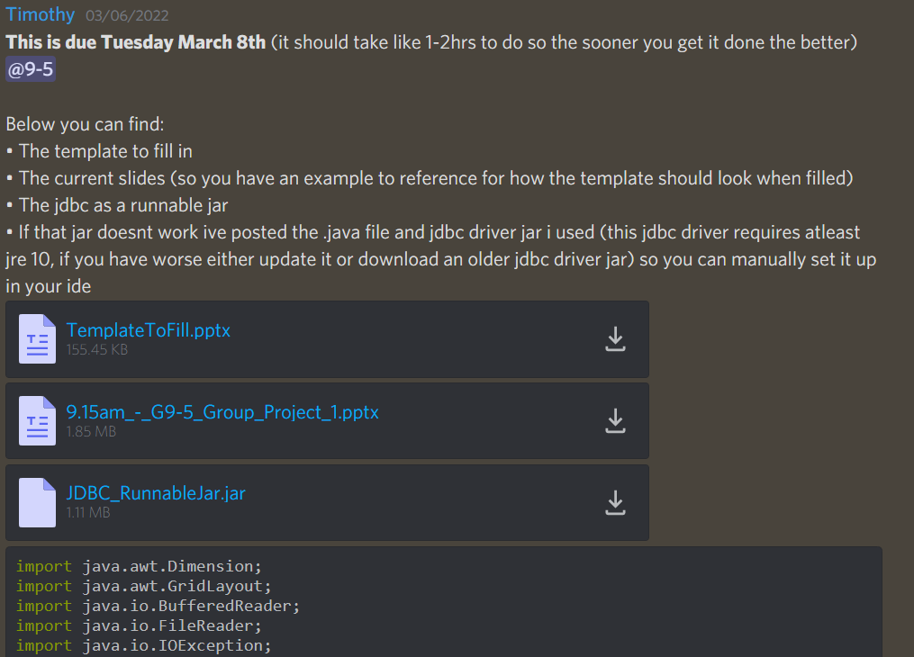
Example: Utilizing Discord to announce deadlines for people, as well as provide information

Slide 9
Group Assistance
Provided feedback on JDBC
E.g., one member mentioned that outputting “NULL” value as blank cells in a table is not intuitive
Adjusted output table to specify they are NULL cells
E.g., provided input on how to implement functionality properly
For instance, implementing a row counter to JDBC output table to mimic that aspect of the SSMS output
Provided feedback on Queries
E.g., pointing out where queries may be failing to meet required criteria to fit as a simple/medium/complex query
E.g., explaining how things work using T-SQL had they misunderstood or not understood how something works
Helped resolve issues with running the JDBC
Primarily related to setting up a JDBC driver compatible with their JRE to run the JDBC

Slide 10
To-Do List and Gannt Chart

Slide 11
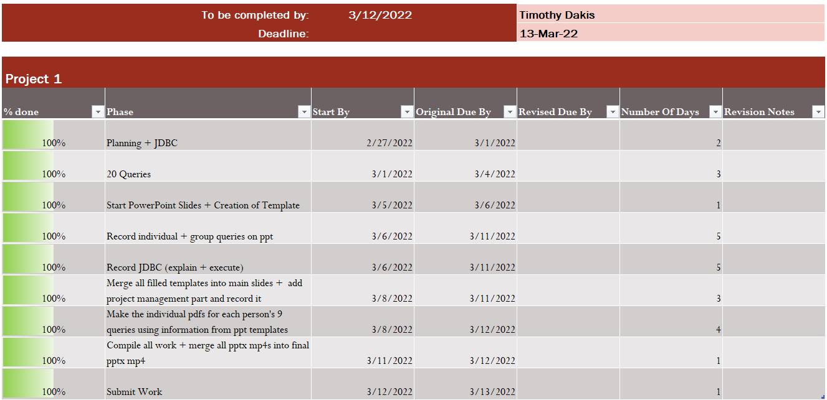
To-Do List For Timothy Dakis

Slide 12
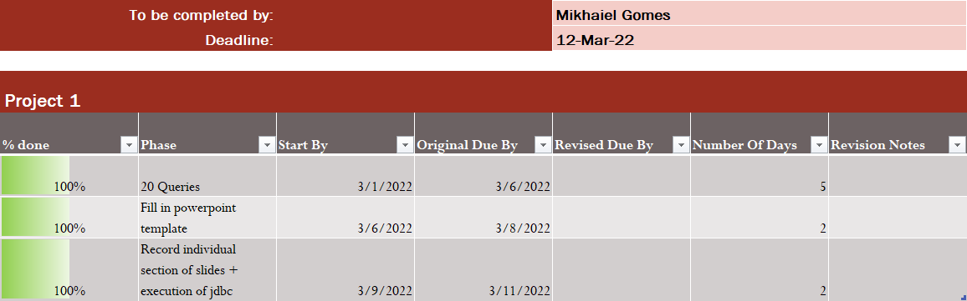
To-Do List For Mikhaiel Gomes

Slide 13
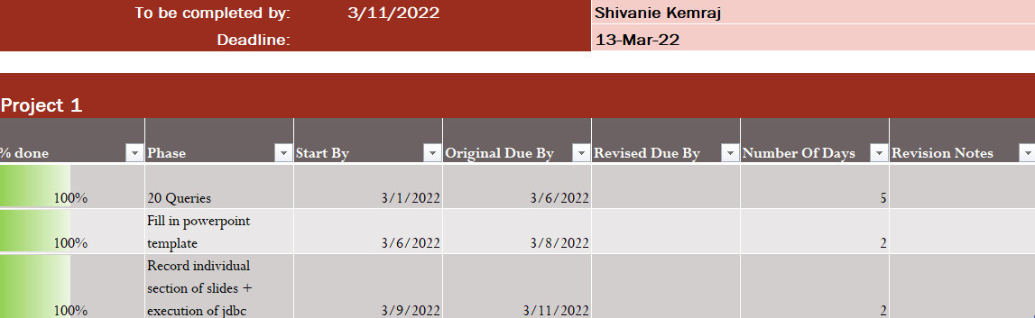
To-Do List For Shivanie Kemraj

Slide 14
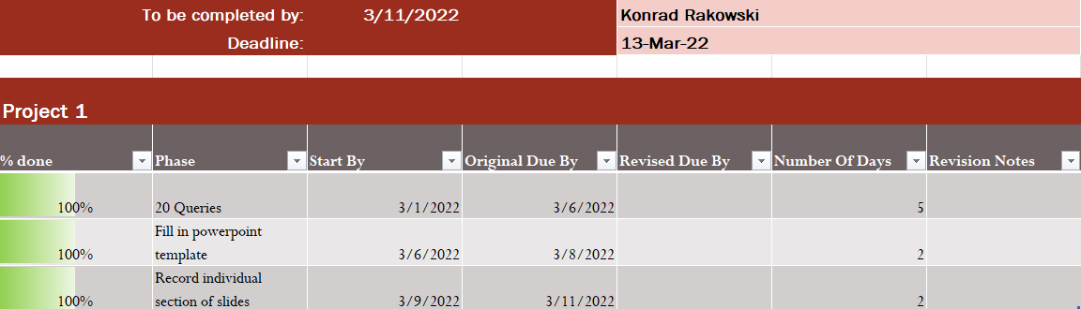
To-Do List For Konrad Rakowski

Slide 15
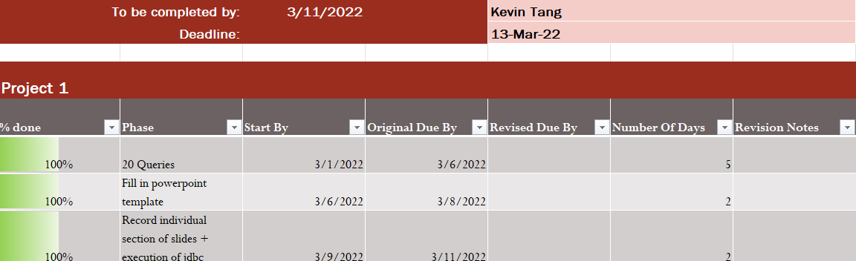
To-Do List For Kevin Tang

Slide 16
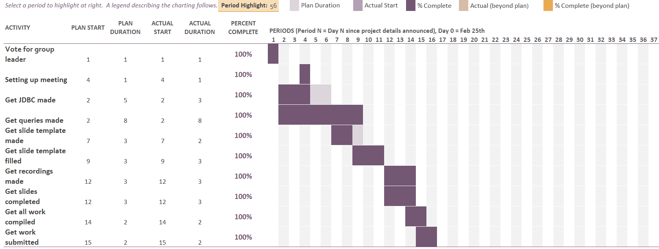
Gannt Chart

Slide 17
Queries
This section of the presentation will go over some queries, it will include:
A showcase of the requirement for the queries
A diagram showing a subsystem of each database
Everyone's top 3 and worst 3 queries individually
Will also show the 3 worst queries correct
The group’s top 3 and worst 3 queries
Will also show the 3 worst queries corrected
For all shown queries, a diagram showing how tables are joined
For all shown queries, a table showing columns outputted
For all shown queries, a table showing how projected is sorted if applicable
For all shown queries, the SSMS, JSON, and JDBC outputs

Slide 18
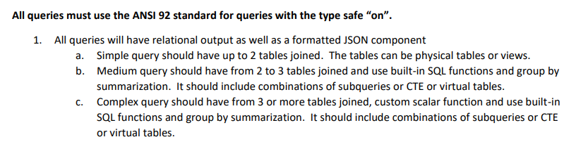
Requirements for Queries

Slide 19
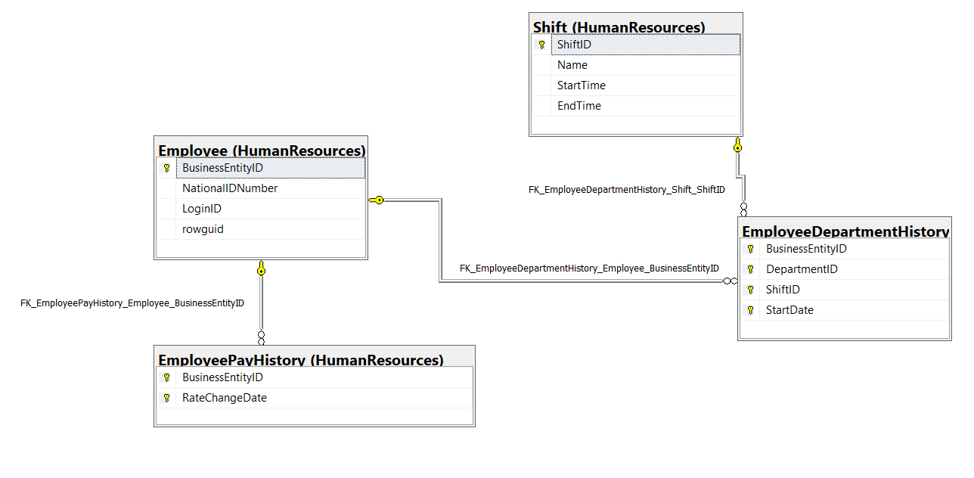
Employee Information Subsystem of AdventureWorks2017

Slide 20
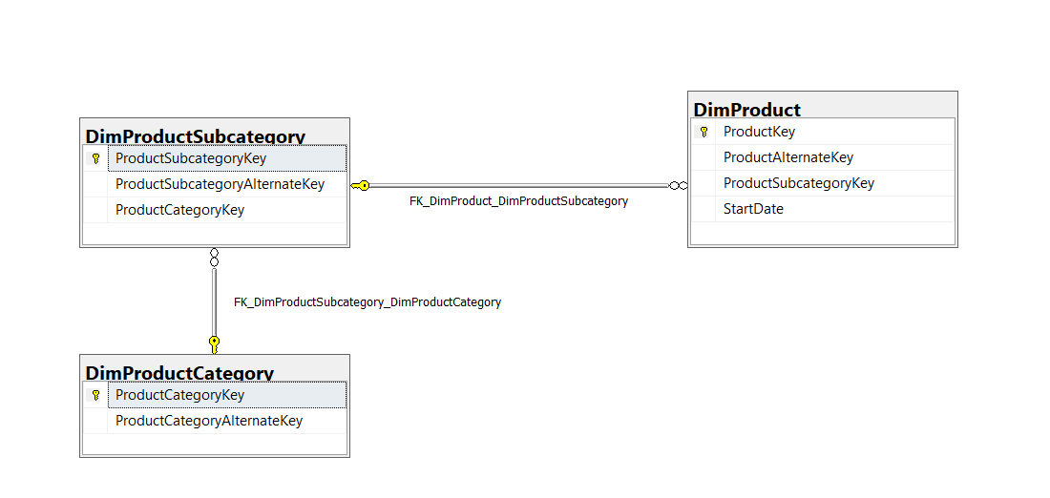
Product Category Subsystem of AdventureWorksDW2017

Slide 21
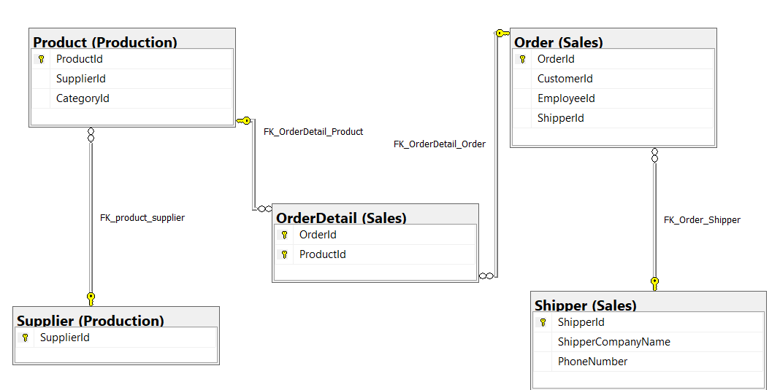
Suppliers’ Shipment Subsystem of Northwinds2022TSQLV7

Slide 22
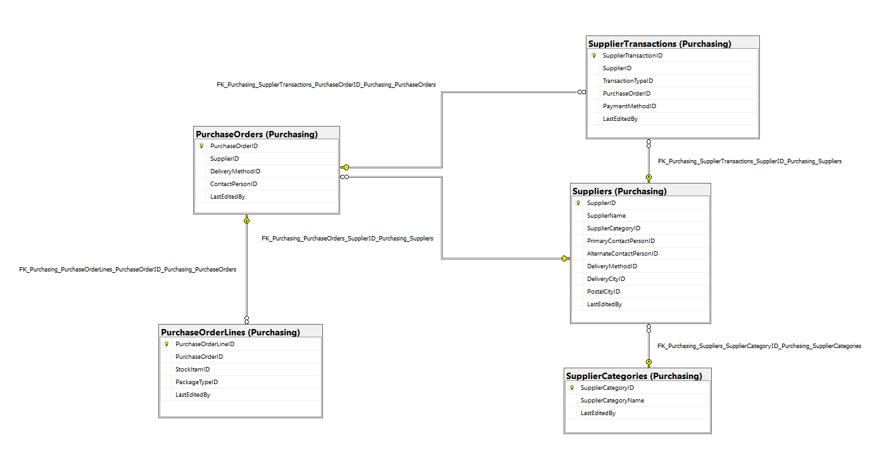
Supplier Information Subsystem of WideWorldImporters

Slide 23
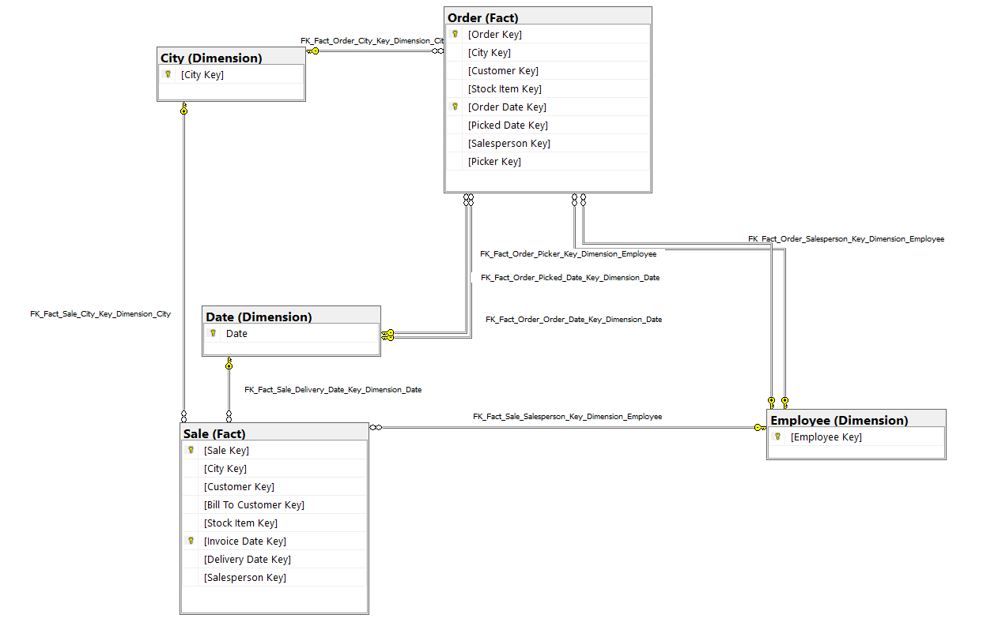
Order Information Subsystem of WideWorldImportersDW

Slide 24
Queries of Timothy Dakis

Slide 25
Top 3 Queries of Timothy Dakis

Slide 26
Top # 1 - Problem 14 (Complex): Find which quarter of each year every employee handled most of their orders, how much those orders were worth after discount, and list employees by name using Northwinds2022TSQLV7
Reasoning:
All things considered it is readable for what it is doing, has a decent logical flow, and it makes use of a lot of concepts learned by this point in this course. So, I feel like it is a good representation of the fruits of that learning

Slide 27
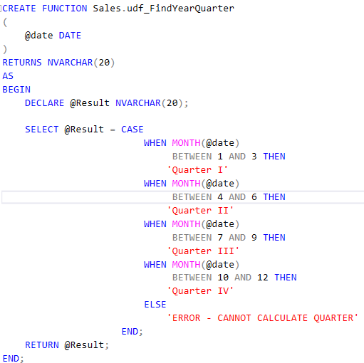
Custom Function #1 Used: FindYearQuarter

Slide 28
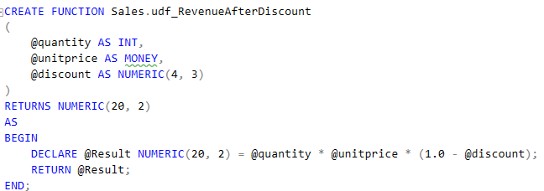
Custom Function #2 Used: RevenueAfterDiscount

Slide 29
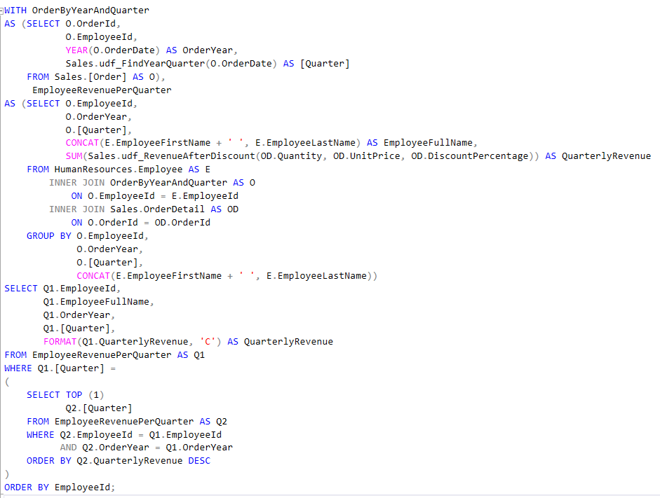
Query

Slide 30
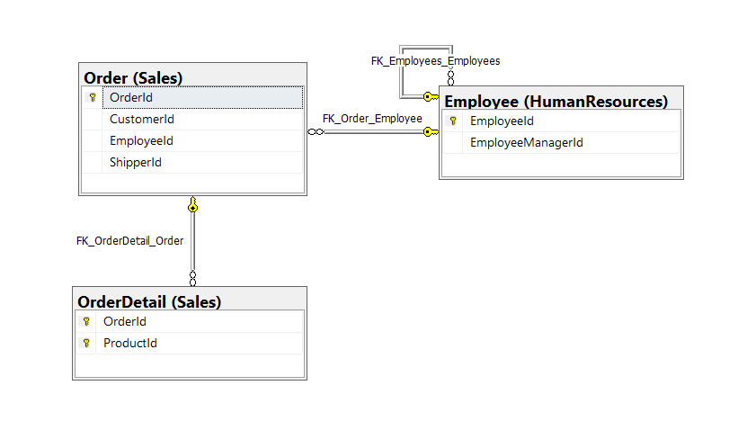
Key View of Tables Used Diagram

Slide 31
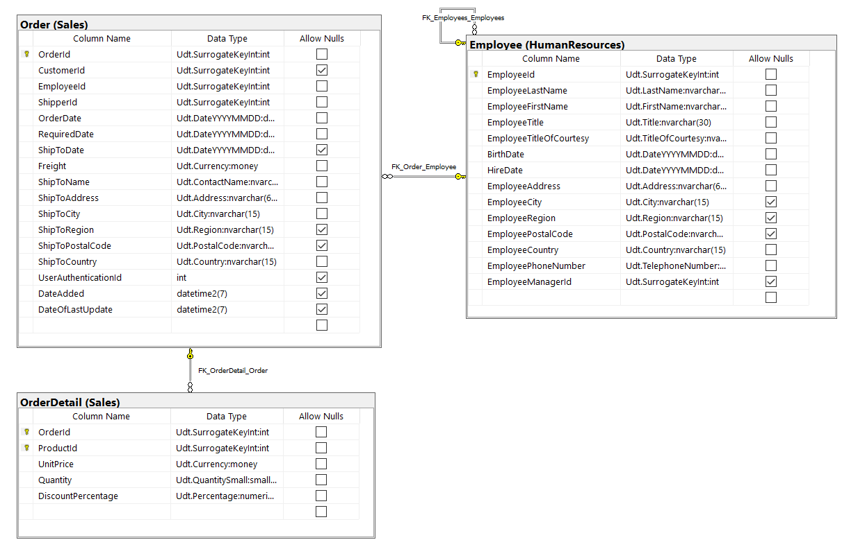
Standard View of Tables Used Diagram

Slide 32
Informatic Table: Columns Projection
Table Name | Column Name
Order | EmployeeId
Derived | EmployeeFullName OrderYear QuarterlyRevenue Quarter

Slide 33
Informatic Table: Projection Sorting
Table Name | Column Name | Sort Order
Order | EmployeeId | ASC

Slide 34
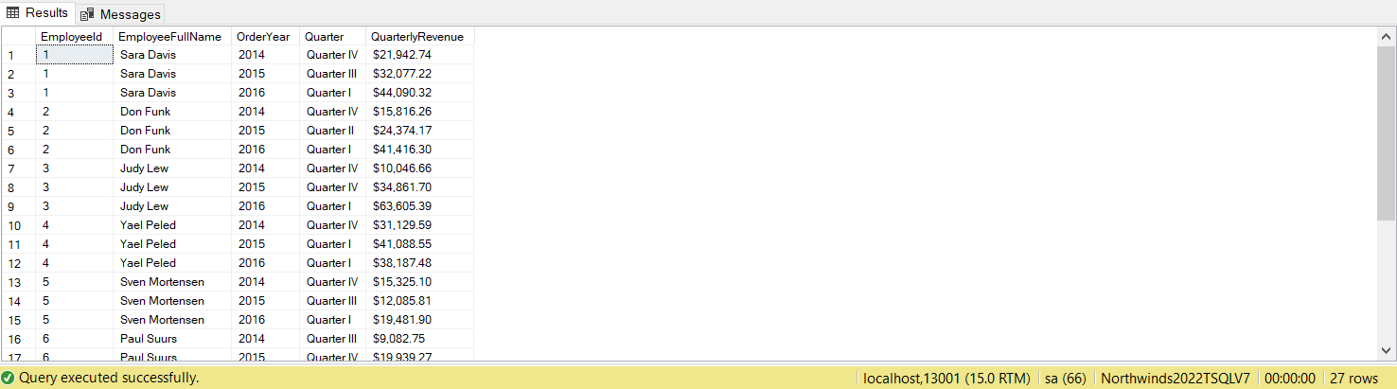
SSMS Output (27 Rows Affected)

Slide 35
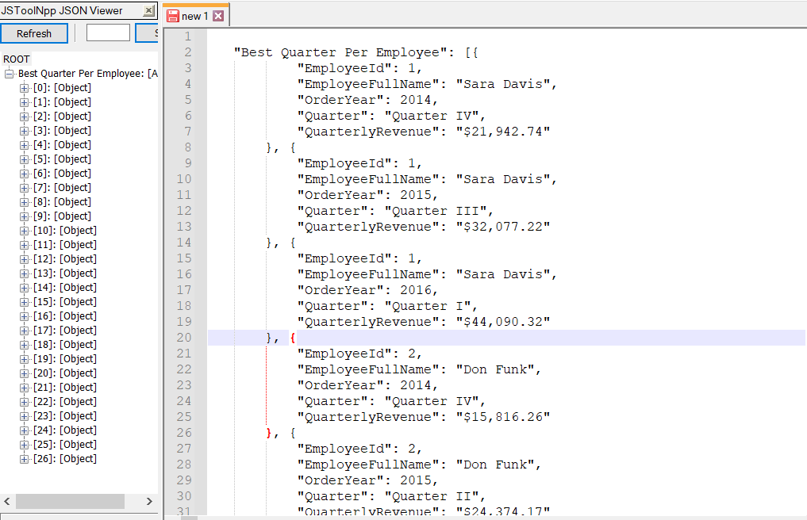
JSON Output

Slide 36
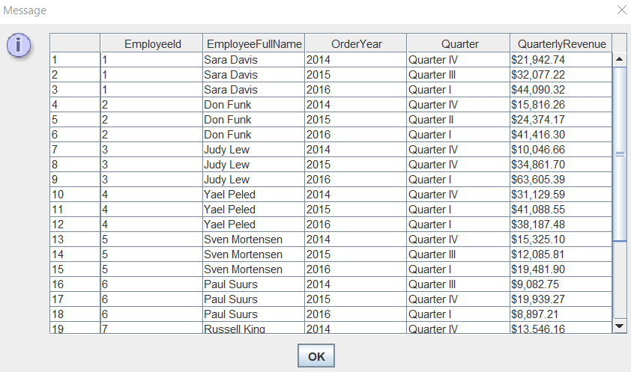
JDBC Output

Slide 37
Top # 2 - Problem 17 (Complex): List all dates between the earliest and most recent order, and if an order has been placed or not, and how much all orders cost on each date after discount using Northwinds2022TSQLV4
Reasoning:
This is a top because I think its pretty interesting and has a pretty nice logical flow and read to it. It also makes use of an auxiliary numbers table to assist in querying which is pretty interesting to utilize

Slide 38
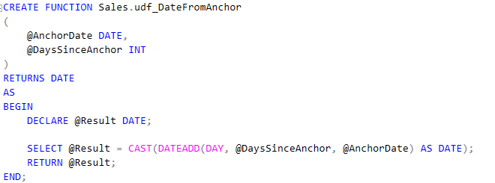
Custom Function #1 Used: DateFromAnchor

Slide 39
Custom Function #2 Used: RevenueAfterDiscount

Slide 40
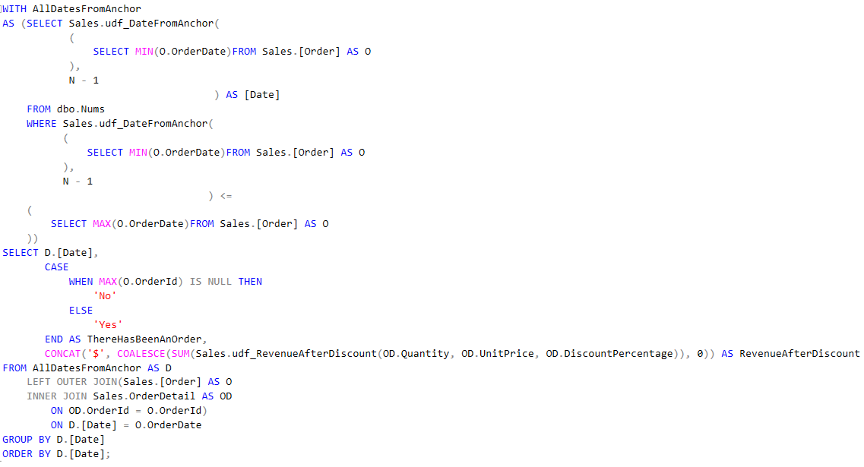
Query

Slide 41
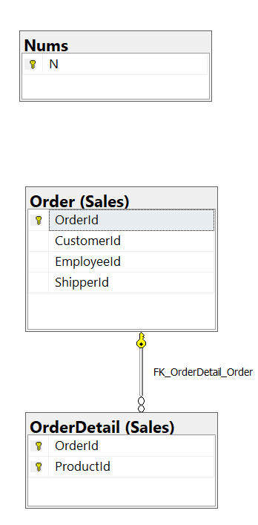
Key View of Tables Used Diagram

Slide 42
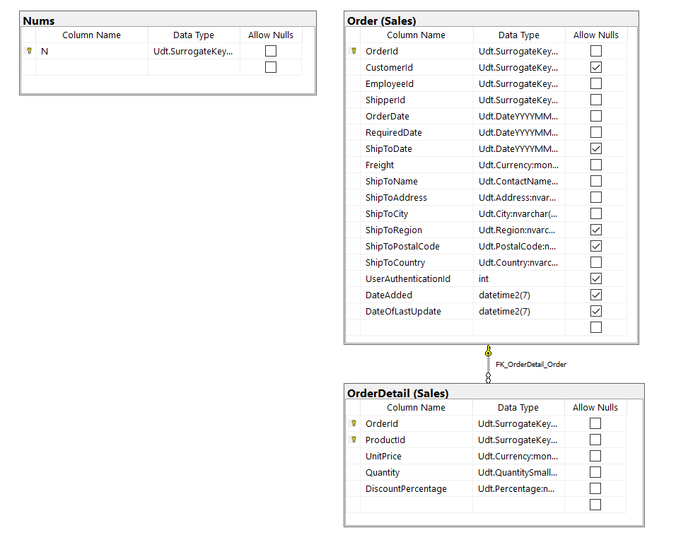
Standard View of Tables Used Diagram

Slide 43
Informatic Table: Columns Projection
Table Name | Column Name
Derived | Date ThereHasBeenAnOrder RevenueAfterDiscount

Slide 44
Informatic Table: Projection Sorting
Table Name | Column Name | Sort Order
Derived | Date | ASC

Slide 45
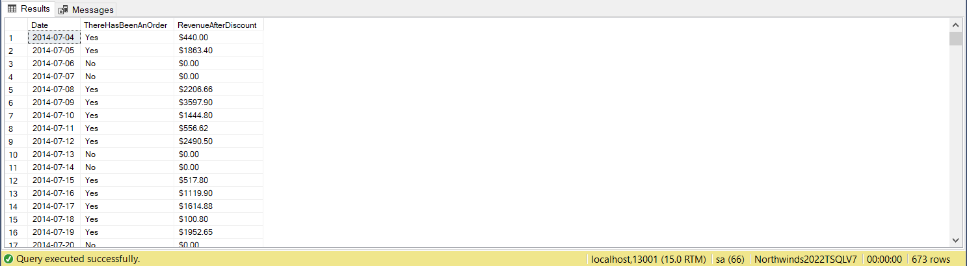
SSMS Output (673 Rows Affected)

Slide 46
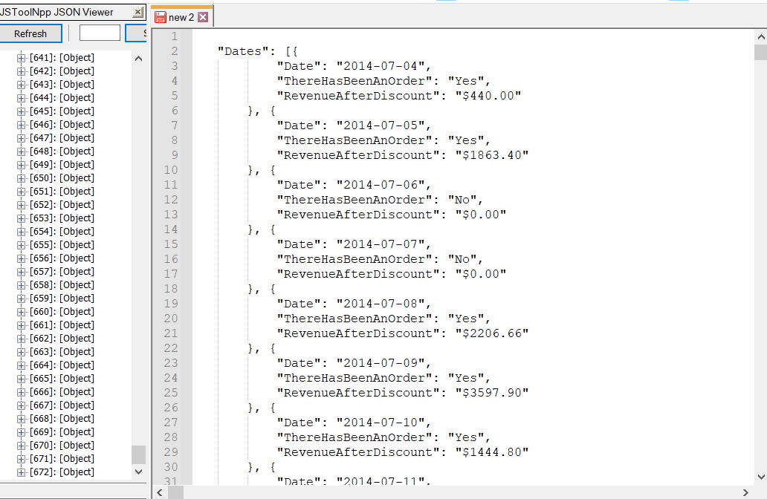
JSON Output

Slide 47
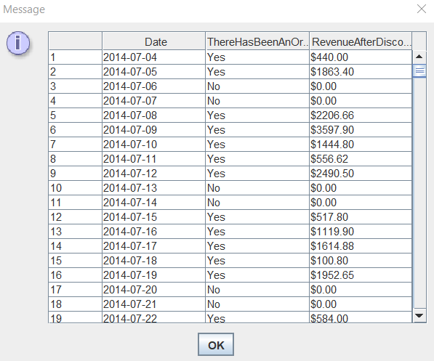
JDBC Output

Slide 48
Top # 3 - Problem 16 (Complex): What type of product is ordered most often per customer country using Northwinds2022TSQLV7
Reasoning:
While a bit messy I think this query is pretty interesting and has a somewhat decent logical flow to it, utilizing CTE and functions and a subquery to break down the top per country

Slide 49
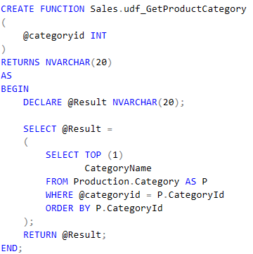
Custom Function #1 Used: GetProductCategory

Slide 50
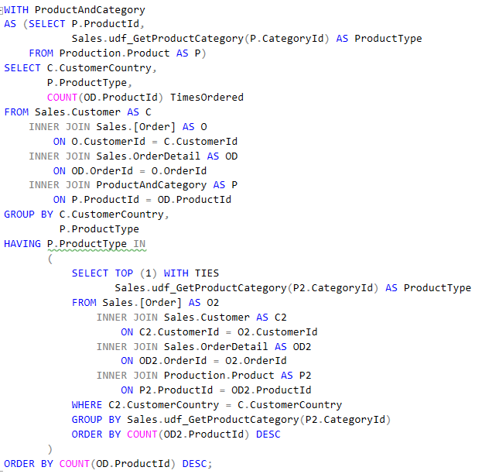
Query

Slide 51
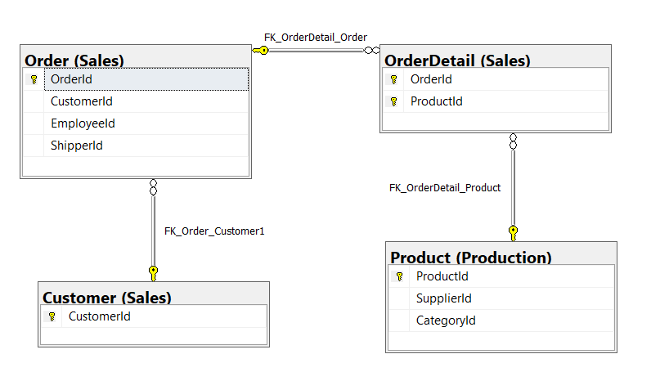
Key View of Tables Used Diagram

Slide 52
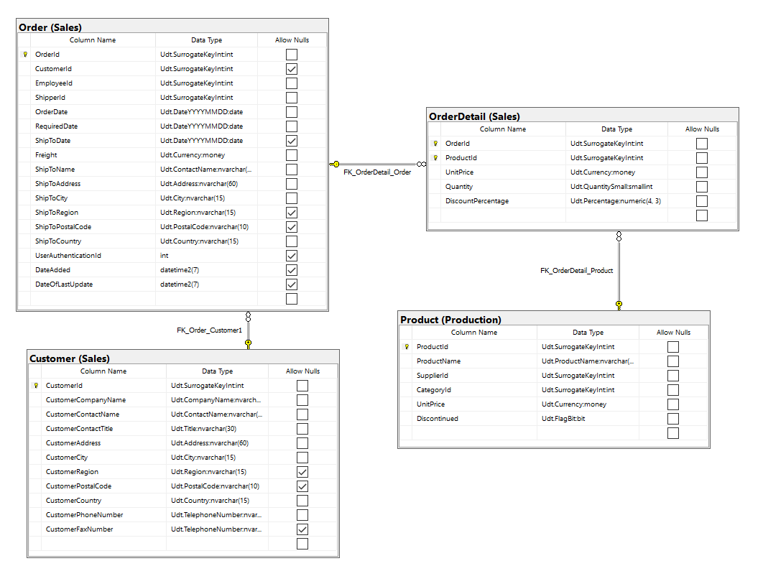
Standard View of Tables Used Diagram

Slide 53
Informatic Table: Columns Projection
Table Name | Column Name
Customer | CustomerCountry
Derived | ProductType TimesOrdered

Slide 54
Informatic Table: Projection Sorting
Table Name | Column Name | Sort Order
Derived | COUNT(ProductId) | DESC

Slide 55
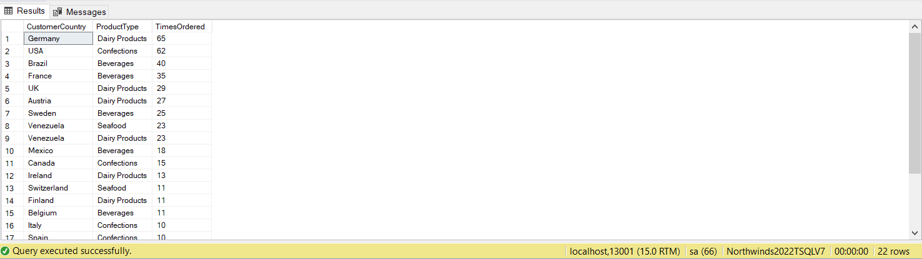
SSMS Output (22 Rows Affected)

Slide 56
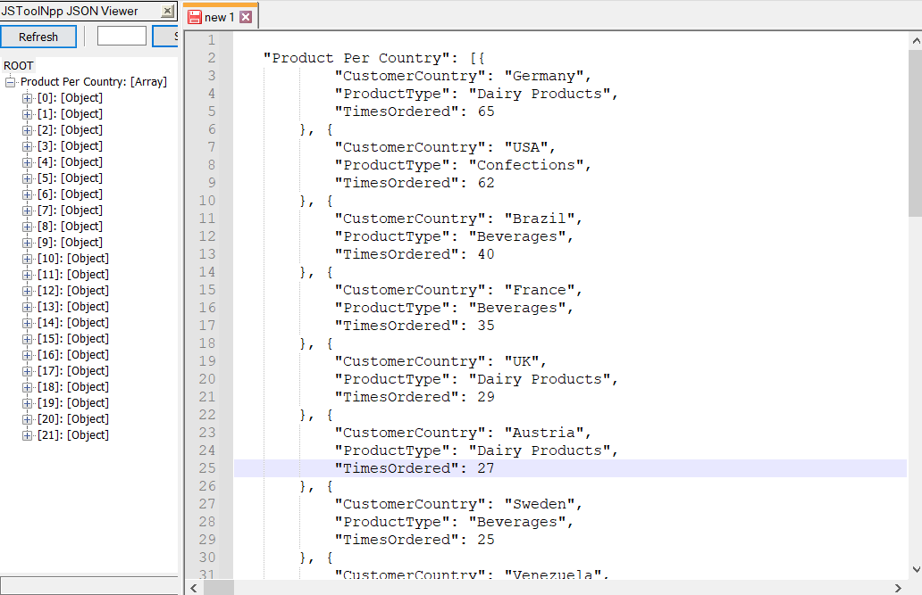
JSON Output

Slide 57
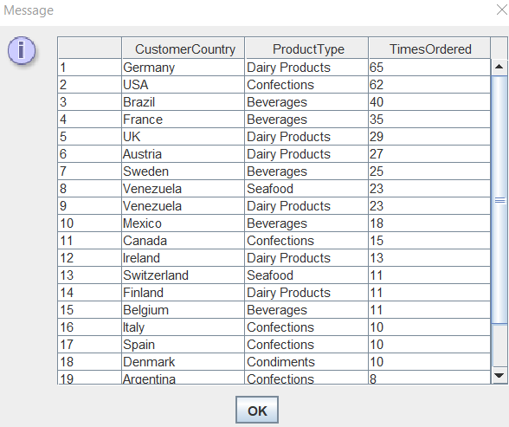
JDBC Output

Slide 58
Worst 3 Queries of Timothy Dakis

Slide 59
Worst # 1 - Problem 02 (Simple): What products need to be reordered (replenished) using AdventureWorks2017?
Reasoning:
While required, it just does not make sense to group by ReorderPoint even though it does not negatively affect outcome as ReorderPoint for each ProductId is the same

Slide 60
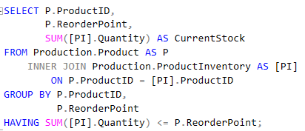
Query

Slide 61
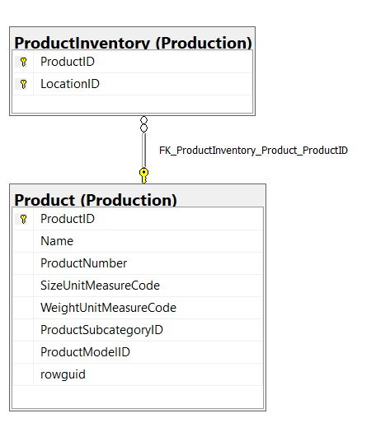
Key View of Tables Used Diagram

Slide 62
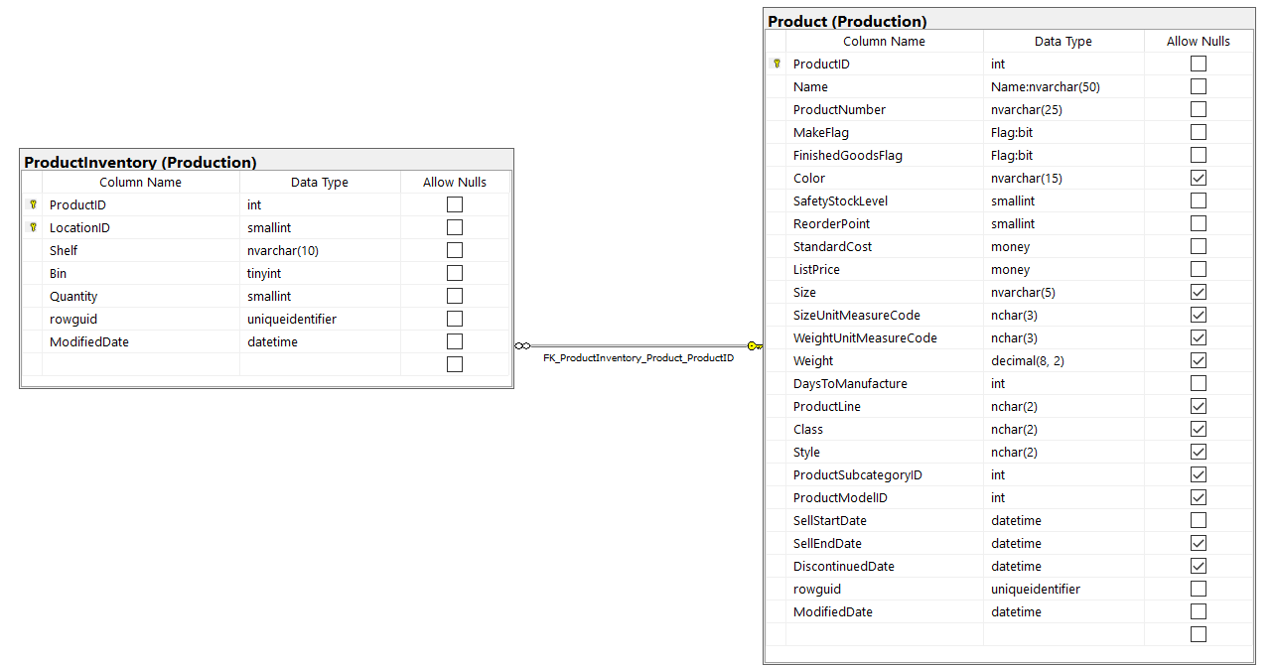
Standard View of Tables Used Diagram

Slide 63
Informatic Table: Columns Projection
Table Name | Column Name
Product | ProductId ReorderPoint
Derived | CurrentStock

Slide 64
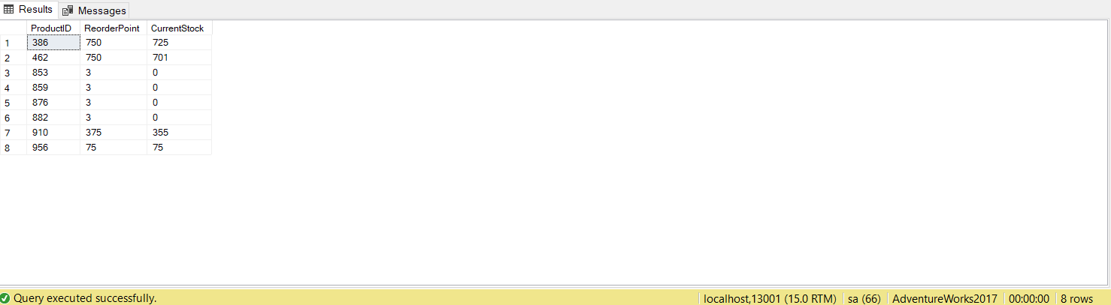
SSMS Output (8 Rows Affected)

Slide 65
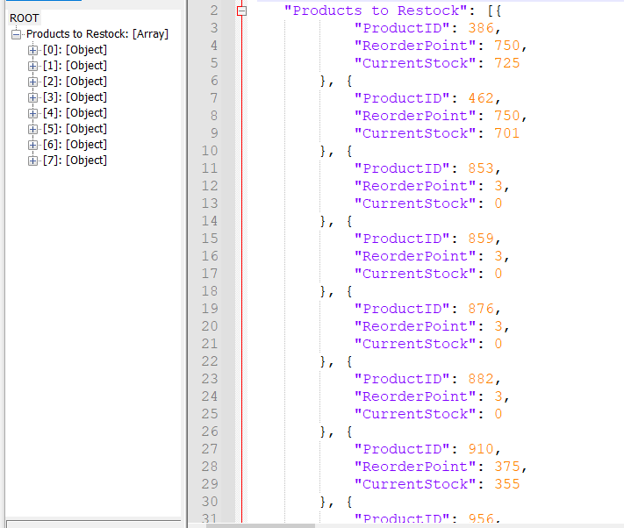
JSON Output

Slide 66
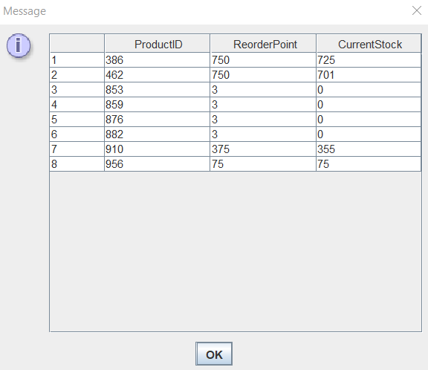
JDBC Output

Slide 67
Worst # 1 (Corrected) - Problem 02 (Simple): What products need to be reordered (replenished) using AdventureWorks2017?
Correction:
Using a CTE makes the logical flow better and makes it mildly more readable. Also does not need to group by things it does not make sense to group by

Slide 68
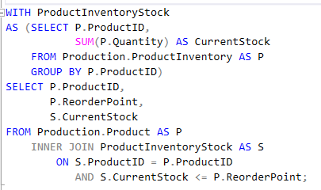
Query

Slide 69
Key View of Tables Used Diagram

Slide 70
Standard View of Tables Used Diagram

Slide 71
Informatic Table: Columns Projection
Table Name | Column Name
Product | ProductId ReorderPoint
Derived | CurrentStock

Slide 72
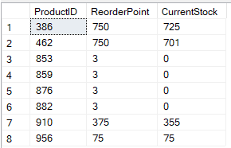
SSMS Output (8 Rows Affected)

Slide 73
JSON Output

Slide 74
JDBC Output

Slide 75
Worst # 2 - Problem 08 (Medium): How much has every supplier sold using Northwinds2022TSQLV7?
Reasoning:
Use of CTE largely unnecessary, just reduces readability as opposed to improving it as is the goal with CTEs

Slide 76
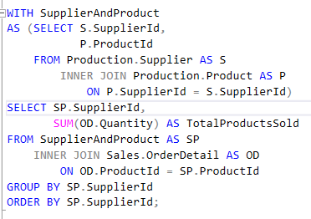
Query

Slide 77
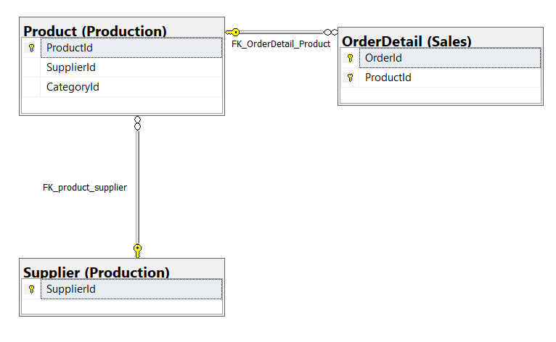
Key View of Tables Used Diagram

Slide 78
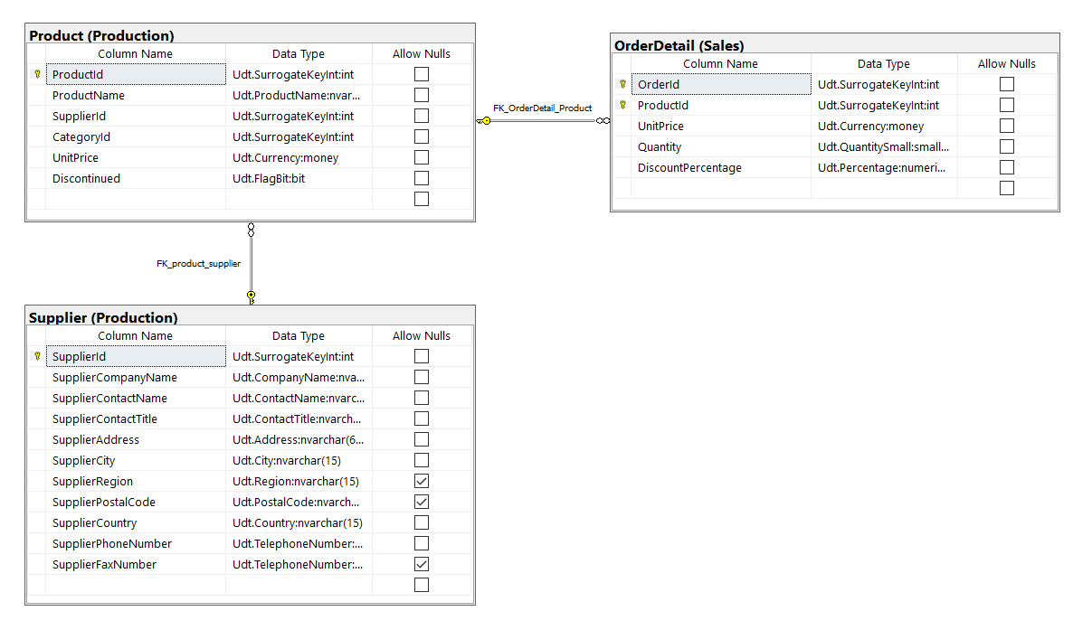
Standard View of Tables Used Diagram

Slide 79
Informatic Table: Columns Projection
Table Name | Column Name
Supplier | SupplierId
Derived | TotalProductSold

Slide 80
Informatic Table: Projection Sorting
Table Name | Column Name | Sort Order
Supplier | SupplierId | ASC

Slide 81
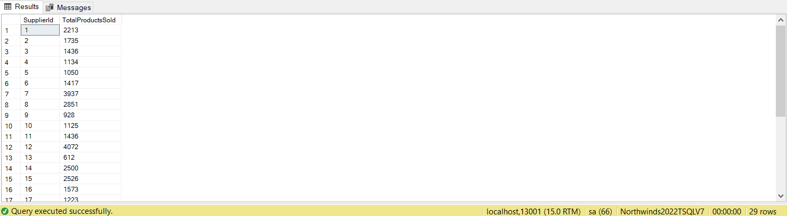
SSMS Output (29 Rows Affected)

Slide 82
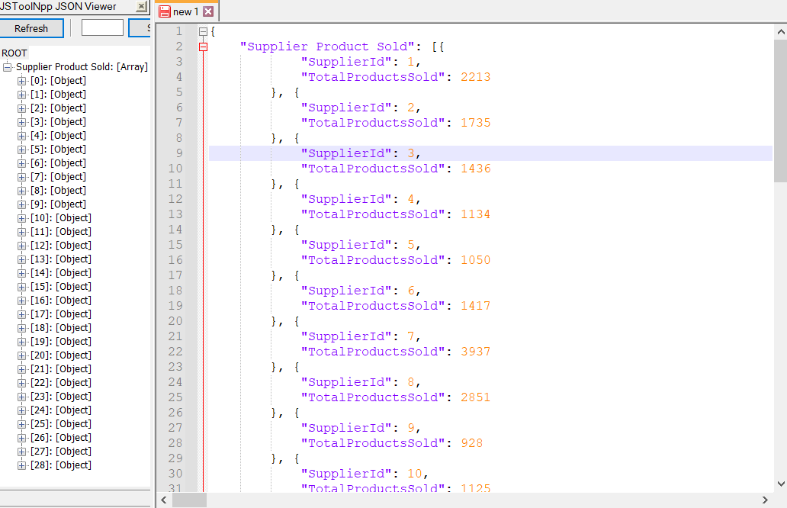
JSON Output

Slide 83

JDBC Output

Slide 84
Worst # 2 (Corrected) - Problem 08 (Medium): How much has every supplier sold using Northwinds2022TSQLV7?
Correction:
Removal of CTE with just a direct 3 table join makes the query more readable

Slide 85

Query

Slide 86
Key View of Tables Used Diagram

Slide 87
Standard View of Tables Used Diagram

Slide 88
Informatic Table: Columns Projection
Table Name | Column Name
Supplier | SupplierId
Derived | TotalProductSold

Slide 89
Informatic Table: Projection Sorting
Table Name | Column Name | Sort Order
Supplier | SupplierId | ASC

Slide 90
SSMS Output (29 Rows Affected)

Slide 91
JSON Output

Slide 92
JDBC Output

Slide 93
Worst # 3 - Problem 13 (Medium): How much revenue was generated by each gender (assuming only male/female gender) in 2015 using Northwinds2022TSQLV7
Reasoning:
The many derived tables hinder readability

Slide 94

Query

Slide 95

Key View of Tables Used Diagram

Slide 96

Standard View of Tables Used Diagram

Slide 97
Informatic Table: Columns Projection
Table Name | Column Name
Derived | Gender RevenueAfterDiscount

Slide 98
Informatic Table: Projection Sorting
Table Name | Column Name | Sort Order
Derived | SUM(EmployeeRevenue) | DESC

Slide 99

SSMS Output (3 Rows Affected)

Slide 100

JSON Output

Slide 101

JDBC Output

Slide 102
Worst # 3 (Corrected) - Problem 13 (Medium): How much revenue was generated by each gender (assuming only male/female gender) in 2015 using Northwinds2022TSQLV7
Correction:
Used CTEs to improve readability and give it a more logical flow

Slide 103

Query

Slide 104
Key View of Tables Used Diagram

Slide 105
Standard View of Tables Used Diagram

Slide 106
Informatic Table: Columns Projection
Table Name | Column Name
Derived | Gender RevenueAfterDiscount

Slide 107
Informatic Table: Projection Sorting
Table Name | Column Name | Sort Order
Derived | SUM(EmployeeRevenue) | DESC

Slide 108
SSMS Output (3 Rows Affected)

Slide 109
JSON Output

Slide 110
JDBC Output

Slide 111
Queries of Mikhaiel Gomes

Slide 112
Top 3 Queries of Mikhaiel Gomes

Slide 113
Top # 1 - Problem 13 (Complex): Find the top 5 spending customers using Northwinds2022TSQLV7.
Reasoning:
My solution for it uses a user defined scalar function to find total spent which essentially helps avoiding multiple inner joins in the main query.

Slide 114

Custom Function #1 Used: TotalSpent

Slide 115

Query

Slide 116

Key View of Tables Used Diagram

Slide 117

Standard View of Tables Used Diagram

Slide 118
Informatic Table: Columns Projection
Table Name | Column Name
Derived | TotalSpent
Sales.Customer | CustomerContactName As Name
Sales.OrderDetail | ShipToCity As City

Slide 119
Informatic Table: Projection Sorting
Table Name | Column Name | Sort Order
Derived | Total Spent | Decending

Slide 120

SSMS Output (5 Rows Affected)

Slide 121

JSON Output

Slide 122

JDBC Output

Slide 123
Top # 2 - Problem 04 (Complex): For each category and sub category of products show the total sales made for each quarter in 2013 using AdventureWorks2017
Reasoning:
Utilizes built in functions of SQL to avoid writing UDFs.

Slide 124

Query

Slide 125

Key View of Tables Used Diagram

Slide 126

Standard View of Tables Used Diagram

Slide 127
Informatic Table: Columns Projection
Table Name | Column Name
Production.ProductCategory | Name as Category
Production.ProductSubcategory | Name AS Subcategory
Derived | Year Qtr $ Sales

Slide 128
Informatic Table: Projection Sorting
Table Name | Column Name | Sort Order
Production.ProductCategory | Name as Category | Ascending
Production.ProductSubcategory | Name AS Subcategory | Ascending
Qtr | Derived | Ascending

Slide 129

SSMS Output (112 Rows Affected)

Slide 130

JSON Output

Slide 131

JDBC Output

Slide 132
Top # 3 - Problem 11 (Complex): Show all for how many years the employees has been hired for and their pay rates using AdventureWorks2017
Reasoning:
Interesting problem that uses UDF, built in functions, multiple table joins to find the result.

Slide 133

Custom Function #1 Used:

Slide 134

Query

Slide 135

Key View of Tables Used Diagram

Slide 136

Standard View of Tables Used Diagram

Slide 137
Informatic Table: Columns Projection
Table Name | Column Name
Derived | Name Worklength
HumanResources.EmployeePayHistory | Rate

Slide 138
Informatic Table: Projection Sorting
Table Name | Column Name | Sort Order
HumanResources.EmployeePayHistory | Rate | ASC
Derived | WorkLength | ASC
Person.Person | LastName | ASC

Slide 139

SSMS Output (316 Rows Affected)

Slide 140

JSON Output

Slide 141

JDBC Output

Slide 142
Worst 3 Queries of Mikhaiel Gomes

Slide 143
Worst # 1 - Problem 14 (Medium): For customers in WideWorldImportersDW find out for the customers who bought developer joke mug, how many have they purchased?
Reasoning:
In the Dimension.Customer table there are information for unknown customers. Which is problematic when we do the joins and get unwanted row in our result table.

Slide 144

Query

Slide 145

Key View of Tables Used Diagram

Slide 146

Standard View of Tables Used Diagram

Slide 147
Informatic Table: Columns Projection
Table Name | Column Name
Dimension.Customer | Primary Contact
Derived | Number Of Mugs

Slide 148
Informatic Table: Projection Sorting
Table Name | Column Name | Sort Order
Derived | Number of Mugs | Desc

Slide 149

SSMS Output (403 Rows Affected)

Slide 150

JSON Output

Slide 151

JDBC Output

Slide 152
Worst # 1 (Corrected) - Problem 14 (Medium): For customers in WideWorldImportersDW find out for the customers who bought developer joke mug, how many have they purchased?
Correction:
Identified the issue by inspecting the Dimension.Customer table and found that unknown customers were given the Customer Id of 0. Avoiding this ID in the where clause solved the issue.

Slide 153

Query

Slide 154

Key View of Tables Used Diagram

Slide 155

Standard View of Tables Used Diagram

Slide 156
Informatic Table: Columns Projection
Table Name | Column Name
Derived | Name Worklength
HumanResources.EmployeePayHistory | Rate

Slide 157
Informatic Table: Projection Sorting
Table Name | Column Name | Sort Order
Derived | Number of Mugs | Desc

Slide 158

SSMS Output (402 Rows Affected)

Slide 159

JSON Output

Slide 160

JDBC Output

Slide 161
Worst # 2 - Problem 17 (Medium): Find information about all the customers who purchased white mug/s in February using WideWorldImportersDW
Reasoning:
Even thought the query works, it doesn’t take into consideration that the current REGEX operation can only look of the string ‘mug’ then ‘white’. If there were to be any description where the description said “white mug’ then we wouldn’t get the desired result.

Slide 162

Query

Slide 163

Key View of Tables Used Diagram

Slide 164

Standard View of Tables Used Diagram

Slide 165
Informatic Table: Columns Projection
Table Name | Column Name
Fact.[Order] | Quantity Order Date Key
Dimension.Customer | Customer
Fact.Sale | Salesperson Key

Slide 166
Informatic Table: Projection Sorting
Table Name | Column Name | Sort Order
Fact.Sale | SalesPerson Key | ASC
Fact.[Order] | Order Date Key | ASC

Slide 167

SSMS Output (1153 Rows Affected)

Slide 168

JSON Output

Slide 169

JDBC Output

Slide 170
Worst # 2 (Corrected) - Problem 17 (Medium): Find information about all the customers who purchased white mug/s in February using WideWorldImportersDW
Correction:
Separate REGEX for ‘white’ and ‘mug’ have been implemented to avoid exceptions.

Slide 171

Query

Slide 172
Key View of Tables Used Diagram

Slide 173
Standard View of Tables Used Diagram

Slide 174
Informatic Table: Columns Projection
Table Name | Column Name
Fact.[Order] | Quantity Order Date Key
Dimension.Customer | Customer
Fact.Sale | Salesperson Key

Slide 175
Informatic Table: Projection Sorting
Table Name | Column Name | Sort Order
Fact.Sale | SalesPerson Key | ASC
Fact.[Order] | Order Date Key | ASC

Slide 176

SSMS Output (1153 Rows Affected)

Slide 177

JSON Output

Slide 178
JDBC Output

Slide 179
Worst # 3 - Problem 18 (Medium): From WideWorldImporters find the regular customers who has average transaction amount above -5000 for the last 3 months of 2015.
Reasoning:
From the REGEX clauses it is not apparent why the Wingtip and Tailspin are being avoided.

Slide 180

Query

Slide 181

Key View of Tables Used Diagram

Slide 182

Standard View of Tables Used Diagram

Slide 183
Informatic Table: Columns Projection
Table Name | Column Name
Sales.Customers | CustomerName
Derived | Average Transaction

Slide 184
Informatic Table: Projection Sorting
Table Name | Column Name | Sort Order
Derived | Average Transaction | ASC

Slide 185

SSMS Output (255 Rows Affected)

Slide 186

JSON Output

Slide 187

JDBC Output

Slide 188
Worst # 3 (Corrected) - Problem 18 (Medium): From WideWorldImporters find the regular customers who has average transaction amount above -5000 for the last 3 months of 2015.
Correction:
Apart from the toy stores all the other customers are regular customers. And it is logical to check if the customer is not a toy store than looking for each toy stores names individually. It also runs regex for one string rather than multiple, which is optimal.

Slide 189

Query

Slide 190
Key View of Tables Used Diagram

Slide 191
Standard View of Tables Used Diagram

Slide 192
Informatic Table: Columns Projection
Table Name | Column Name
Sales.Customers | CustomerName
Derived | Average Transaction

Slide 193
Informatic Table: Projection Sorting
Table Name | Column Name
Sales.Customers | CustomerName
Derived | Average Transaction

Slide 194
SSMS Output (255 Rows Affected)

Slide 195
JSON Output

Slide 196
JDBC Output

Slide 197
Queries of Shivanie Kemraj

Slide 198
Top 3 Queries of Shivanie Kemraj

Slide 199
Top # 1 - Problem 04 (Easy): return orderkey with unit price using WideWorldImportersDW
Reasoning:
sorted by order key

Slide 200
Query
USE WideWorldImportersDW;
SELECT [Order Key]
,[Unit Price]
FROM Fact.[Order]
ORDER BY [Order Key];

Slide 201

Key View of Tables Used Diagram

Slide 202

Standard View of Tables Used Diagram

Slide 203
Informatic Table: Columns Projection
Table Name | Column Name
Fact.Order | Order Key Unit Price

Slide 204
Informatic Table: Projection Sorting
Table Name | Column Name | Sort Order
Fact.Order | Order Key | ASC

Slide 205

Azure Output (231412 Rows Affected)

Slide 206

JSON Output

Slide 207

JDBC Output

Slide 208
Top # 2 - Problem 07 (Medium): returns concated employee's name with order id
using Northwinds2022TSQLV7
Reasoning:
uses an inner join rather than cross join

Slide 209
Query
USE Northwinds2022TSQLV7;
SELECT CONCAT (
E.EmployeeFirstName
,' '
,E.EmployeeLastName
) AS FullName
,O.OrderID
FROM HumanResources.Employee AS E
INNER JOIN Sales.[Order] AS O ON E.EmployeeId = (
SELECT O.EmployeeId
)
GROUP BY O.OrderID
,E.EmployeeFirstName
,E.EmployeeLastName
FOR json path
,root(' NAME ')
,include_null_values;

Slide 210

Key View of Tables Used Diagram

Slide 211

Standard View of Tables Used Diagram

Slide 212
Informatic Table: Columns Projection
Table Name | Column Name
HumanResources.Employee | FullName (using EmployeeFirstName , EmployeeLastName)
Sales.Order | OrderID

Slide 213

Azure Output (831 Rows Affected)

Slide 214

JSON Output

Slide 215

JDBC Output

Slide 216
Top # 3 - Problem 20 (Complex): returns custid, emplyid, orderid and the season of the orders
using Northwinds2022TSQLV7
Reasoning:
only scalar function that does something a built in function could not

Slide 217
Custom Function #1 Used: Season
DROP FUNCTION
IF EXISTS Sales.Season;GO
CREATE FUNCTION Sales.Season (@date DATE)
RETURNS NVARCHAR(20)
AS
BEGIN
DECLARE @Result NVARCHAR(20);
DECLARE @Month INT = MONTH(@date);
SELECT @Result = CASE
WHEN @Month IN (
12
,1
,2
)
THEN 'Winter'
WHEN @Month BETWEEN 3
AND 5
THEN 'Spring'
WHEN @Month BETWEEN 6
AND 8
THEN 'Summer'
WHEN @Month BETWEEN 9
AND 11
THEN 'Autumn'
ELSE 'ERROR - CANNOT CALCULATE Season'
END;
RETURN @Result
END;
GO

Slide 218
Query
SELECT C.customerid
,E.employeeid
,O.OrderId
,Sales.Season(O.orderdate) AS [Order Season]
FROM Sales.Customer AS C
CROSS JOIN HumanResources.Employee AS E
CROSS JOIN Sales.[Order] AS O
WHERE C.CustomerId = (
SELECT O.CustomerId
WHERE E.EmployeeId = O.EmployeeId
)
GROUP BY C.customerid
,E.employeeid
,O.OrderId
,Sales.Season(O.orderdate);

Slide 219

Key View of Tables Used Diagram

Slide 220

Standard View of Tables Used Diagram

Slide 221
Informatic Table: Columns Projection
Table Name | Column Name
Sales.Customer | CustomerId
HumanResources.Employee | EmployeeId
Sales.Order | OrderId Order Season (using OrderDate)

Slide 222

Azure Output (830 Rows Affected)

Slide 223

JSON Output

Slide 224

JDBC Output

Slide 225
Worst 3 Queries of Shivanie Kemraj

Slide 226
Worst # 1 - Problem 02 (Simple): return employee's full name with their birthday
using AdventureWorksDW2017
Reasoning:
can use a concat function to do so

Slide 227
Query
USE AdventureWorksDW2017;
SELECT FirstName + ' ' + LastName AS FullName
,BirthDate
FROM dbo.DimEmployee;

Slide 228

Key View of Tables Used Diagram

Slide 229

Standard View of Tables Used Diagram

Slide 230
Informatic Table: Columns Projection
Table Name | Column Name
dbo.DimEmployee | FullName (using FirstName, LastName) BirthDate

Slide 231

Azure Output (296 Rows Affected)

Slide 232

JSON Output

Slide 233

JDBC Output

Slide 234
Worst # 1 (Corrected) - Problem 02 (Simple): return employee's full name with their birthday
using AdventureWorksDW2017
Correction:
used a concate function for better readability

Slide 235
Query
USE AdventureWorksDW2017;
SELECT CONCAT (
FirstName
,' '
,LastName
) AS FullName
,BirthDate
FROM dbo.DimEmployee

Slide 236
Key View of Tables Used Diagram

Slide 237
Standard View of Tables Used Diagram

Slide 238
Informatic Table: Columns Projection
Table Name | Column Name
dbo.DimEmployee | FullName (using FirstName, LastName) BirthDate

Slide 239
Azure Output (296 Rows Affected)

Slide 240
JSON Output

Slide 241
JDBC Output

Slide 242
Worst # 2 - Problem 11 (Medium): returns custid, emplid and order year
using Northwinds2022TSQLV7
Reasoning:
can use a built in function for full name, also can use inner joins to replace the cross join and subquery

Slide 243
Query
USE Northwinds2022TSQLV7;
SELECT CO.CustomerID
,O.EmployeeId
,YEAR(CO.Ordermonth) AS [Year]
FROM Sales.[Order] AS O
CROSS JOIN Sales.uvw_CustomerOrder AS CO
WHERE CO.CustomerID = (
SELECT O.CustomerID
)
GROUP BY CO.CustomerID
,O.EmployeeId
,YEAR(CO.Ordermonth)
ORDER BY CO.CustomerID
,O.EmployeeId;

Slide 244

Key View of Tables Used Diagram

Slide 245

Standard View of Tables Used Diagram

Slide 246
Informatic Table: Columns Projection
Table Name | Column Name
Sales.Order | EmployeeID
Sales.uvw_CustomerOrder | CustomerID Year (using OrderMonth)

Slide 247
Informatic Table: Projection Sorting
Table Name | Column Name | Sort Order
Sales.uvw_CustomerOrder | CustomerID | ASC
Sales.Order | EmployeeId | ASC

Slide 248

Azure Output (1267 Rows Affected)

Slide 249

JSON Output

Slide 250

JDBC Output

Slide 251
Worst # 2 (Corrected) - Problem 11 (Medium): returns custid, emplid and order year
using Northwinds2022TSQLV7
Correction:
used an inner join to replace cross join which now did not need a subquery

Slide 252
Query
USE Northwinds2022TSQLV7;
SELECT CO.CustomerID
,O.EmployeeId
,YEAR(CO.Ordermonth) AS [Year]
FROM Sales.[Order] AS O
INNER JOIN Sales.uvw_CustomerOrder AS CO ON CO.CustomerID = O.CustomerID
GROUP BY CO.CustomerID
,O.EmployeeId
,YEAR(CO.Ordermonth)
ORDER BY CO.CustomerID
,O.EmployeeId;

Slide 253
Key View of Tables Used Diagram

Slide 254
Standard View of Tables Used Diagram

Slide 255
Informatic Table: Columns Projection
Table Name | Column Name
Sales.Order | EmployeeID
Sales.uvw_CustomerOrder | CustomerID Year (using OrderMonth)

Slide 256
Informatic Table: Projection Sorting
Table Name | Column Name | Sort Order
Sales.uvw_CustomerOrder | CustomerID | ASC
Sales.Order | EmployeeId | ASC

Slide 257
Azure Output (1267 Rows Affected)

Slide 258
JSON Output

Slide 259
JDBC Output

Slide 260
Worst # 3 - Problem 14 (Complex): concats the employee's first and last name to make full name; returns the orderid , custid, emplid and name
using Northwinds2022TSQLV7
Reasoning:
can use a built in function for full name, also can use inner joins to replace the cross join and subquery

Slide 261
Custom Function #1 Used: findFullName
USE Northwinds2022TSQLV7;
DROP FUNCTION
IF EXISTS HumanResources.findFullName GO
CREATE FUNCTION HumanResources.findFullName (
@firstName VARCHAR(30)
,@lastName VARCHAR(30)
)
RETURNS VARCHAR(65)
AS
BEGIN
DECLARE @Result VARCHAR(65)
SELECT @RESULT = CONCAT (
@firstname
,' '
,@lastname
)
RETURN @RESULT
END;
GO

Slide 262
Query
SELECT O.OrderId
,C.CustomerId
,E.EmployeeId
,HumanResources.findFullName(E.EmployeeFirstName, E.EmployeeLastName) AS [NAME]
FROM Sales.Customer AS C
CROSS JOIN HumanResources.Employee AS E
CROSS JOIN Sales.[Order] AS O
WHERE C.CustomerId = (
SELECT O.CustomerId
WHERE E.EmployeeId = O.EmployeeId
)
GROUP BY O.OrderId
,C.CustomerId
,E.EmployeeId
,HumanResources.findFullName(E.EmployeeFirstName, E.EmployeeLastName);

Slide 263

Key View of Tables Used Diagram

Slide 264

Standard View of Tables Used Diagram

Slide 265
Informatic Table: Columns Projection
Table Name | Column Name
Sales.Customer | CustomerId
HumanResources.Employee | EmployeeId Name (using EmployeeFirstName, EmployeeLastName)
Sales.Order | OrderId

Slide 266

Azure Output (830 Rows Affected)

Slide 267

JSON Output

Slide 268

JDBC Output

Slide 269
Worst # 3 (Corrected) - Problem 14 (Complex): concats the employee's first and last name to make full name
returns the orderid , custid, emplid and name
using Northwinds2022TSQLV7
Correction:
used built in concate function, also used an inner join to replace cross join which now did not need a subquery

Slide 270
Query
USE Northwinds2022TSQLV7;
SELECT O.OrderId
,C.CustomerId
,E.EmployeeId
,CONCAT (
E.EmployeeFirstName
,' '
,E.EmployeeLastName
) AS [NAME]
FROM Sales.Customer AS C
INNER JOIN Sales.[Order] AS O ON C.CustomerId = O.CustomerId
INNER JOIN HumanResources.Employee AS E ON E.EmployeeId = O.EmployeeId
GROUP BY O.OrderId
,C.CustomerId
,E.EmployeeId
,CONCAT (
E.EmployeeFirstName
,' '
,E.EmployeeLastName
);

Slide 271
Key View of Tables Used Diagram

Slide 272
Standard View of Tables Used Diagram

Slide 273
Informatic Table: Columns Projection
Table Name | Column Name
Sales.Customer | CustomerId
HumanResources.Employee | EmployeeId Name (using EmployeeFirstName, EmployeeLastName)
Sales.Order | OrderId

Slide 274
Azure Output (830 Rows Affected)

Slide 275
JSON Output

Slide 276
JDBC Output

Slide 277
Queries of Konrad Rakowski

Slide 278
Top 3 Queries of Konrad Rakowski

Slide 279
Top # 1 - Problem 02 (Simple): Using Northwinds2022TSQLV7, display orders with a total value less than 15000
Reasoning:
Efficient and relatively easy to read

Slide 280
Query
USE Northwinds2022TSQLV7;
SELECT D.OrderId
,SUM(D.Quantity * D.UnitPrice) AS Total
FROM [Sales].[OrderDetail] AS D
GROUP BY D.OrderId
HAVING SUM(D.Quantity * D.UnitPrice) < 15000
ORDER BY Total DESC;
GO

Slide 281

Key View of Tables Used Diagram

Slide 282

Standard View of Tables Used Diagram

Slide 283
Informatic Table: Columns Projection
Table Name | Column Name
[Sales].[OrderDetail] | OrderId
Derived | Total

Slide 284

Azure Output (827 Rows Affected)

Slide 285

JSON Output

Slide 286

JDBC Output

Slide 287
Top # 2 - Problem 11 (Medium): Using AdventureWorksDW2017, display every employee (oldest to youngest) who’s birthday is in July.
Reasoning:
Interesting Concept and relatively easy to read aswell

Slide 288
Query
USE AdventureWorksDW2017;
WITH MonthName
AS (
SELECT D.EnglishMonthName AS Month
,D.MonthNumberOfYear AS MonthNum
FROM [dbo].[DimDate] AS D
GROUP BY D.EnglishMonthName
,D.MonthNumberOfYear
)
SELECT DISTINCT E.LastName
,E.FirstName
,D.Month
,DAY(E.BirthDate) AS Day
,YEAR(E.BirthDate) AS Year
FROM [dbo].[DimEmployee] AS E
JOIN MonthName AS D ON MONTH(E.BirthDate) = D.MonthNum
WHERE MONTH(E.BirthDate) = 7
ORDER BY Year
,Day
GO

Slide 289

Key View of Tables Used Diagram

Slide 290

Standard View of Tables Used Diagram

Slide 291
Informatic Table: Columns Projection
Table Name | Column Name
[dbo].[DimDate] | EnglishMonthName
[dbo].[DimEmployee] | LastName FirstName
Derived | Day Year

Slide 292
Informatic Table: Projection Sorting
Table Name | Column Name | Sort Order
Derived | Year Day | ASC ASC

Slide 293

Azure Output (28 Rows Affected)

Slide 294

JSON Output

Slide 295

JDBC Output

Slide 296
Top # 3 - Problem 20 (Complex): Using Northwinds2022TSQLV7, display the information of customers who purchased discontinued items
Reasoning:
Separates the main code from function cleanly, allowing for better readability

Slide 297
Custom Function #1 Used: getDiscounted
DROP FUNCTION
IF EXISTS getDiscontinued;GO
CREATE FUNCTION getDiscontinued (@disc AS INT)
RETURNS TABLE
AS
RETURN
SELECT ProductId
,ProductName
,SupplierId
,CategoryId
,UnitPrice
,Discontinued
FROM [Production].[Product]
WHERE Discontinued = @disc;
GO

Slide 298
Query
WITH Ord
AS (
SELECT O.OrderId
,O.OrderDate AS DATE
,O.CustomerId
FROM [Sales].[Order] AS O
GROUP BY O.OrderId
,O.OrderDate
,O.CustomerId
)
,Ord2
AS (
SELECT C.CustomerCompanyName AS CompanyName
,C.CustomerId
FROM [Sales].[Customer] AS C
GROUP BY C.CustomerCompanyName
,C.CustomerId
)
SELECT C.CompanyName
,P.ProductId
,O.OrderId
,O.DATE
,SUM(D.UnitPrice * D.Quantity) AS Paid
FROM Ord2 AS C
JOIN Ord AS O ON C.CustomerId = O.CustomerId
JOIN [Sales].[OrderDetail] AS D ON O.OrderId = D.OrderId
JOIN getDiscontinued(1) AS P ON D.ProductId = P.ProductId
GROUP BY C.CompanyName
,P.ProductId
,O.OrderId
,O.DATE;
GO

Slide 299

Key View of Tables Used Diagram

Slide 300

Standard View of Tables Used Diagram

Slide 301
Informatic Table: Columns Projection
Table Name | Column Name
[Production].[Product] | ProductId
[Sales].[Order] | OrderId, OrderDate
[Sales].[Customer] | CustomerCompanyName
Derived | Paid

Slide 302

Azure Output (228 Rows Affected)

Slide 303

JSON Output

Slide 304

JDBC Output

Slide 305
Worst 3 Queries of Konrad Rakowski

Slide 306
Worst # 1 - Problem 04 (Simple): Using AdventureWorks2017, display the order from the highest orderid
Reasoning:
Can be written much easier and have a simpler output

Slide 307
Query
USE AdventureWorks2017;
SELECT MAX(H.SalesOrderId)
,H.OrderDate
,H.CustomerId
FROM [Sales].[SalesOrderHeader] AS H
GROUP BY H.OrderDate
,H.CustomerID
ORDER BY MAX(H.SalesOrderId) DESC;

Slide 308

Key View of Tables Used Diagram

Slide 309

Standard View of Tables Used Diagram

Slide 310
Informatic Table: Columns Projection
Table Name | Column Name
[Sales].[SalesOrderHeader] | OrderDate, CustomerId
Derived | MAX(SalesOrderId)

Slide 311
Informatic Table: Projection Sorting
Table Name | Column Name | Sort Order
Derived | MAX(SalesOrderId) | DESC

Slide 312

Azure Output (31406 Rows Affected)

Slide 313

JSON Output

Slide 314

JDBC Output

Slide 315
Worst # 1 (Corrected) - Problem 04 (Simple): Using AdventureWorks2017, display the single highest orderid
Correction:
Used a subquery to allow the maximum orderid to only be outputted.

Slide 316
Query
USE AdventureWorks2017;
SELECT H.SalesOrderID
,H.OrderDate
,H.CustomerId
FROM [Sales].[SalesOrderHeader] AS H
WHERE H.SalesOrderID = (
SELECT MAX(H2.SalesOrderId)
FROM [Sales].[SalesOrderHeader] AS H2
);
GO

Slide 317
Key View of Tables Used Diagram

Slide 318
Standard View of Tables Used Diagram

Slide 319
Informatic Table: Columns Projection
Table Name | Column Name
[Sales].[SalesOrderHeader] | SalesOrderId OrderDate CustomerId

Slide 320

Azure Output (1 Row Affected)

Slide 321

JSON Output

Slide 322

JDBC Output

Slide 323
Worst # 2 - Problem 07 (Medium): Using AdventureWorks2017, display how many ‘silver’ products have been sold to an address that is in ‘New York’ (city).
Reasoning:
Can create an extension CTE to make the main a little cleaner.

Slide 324
Query
USE AdventureWorks2017;
WITH Product
AS (
SELECT P.ProductId
,P.Color
FROM [Production].[Product] AS P
WHERE P.Color = 'silver'
)
SELECT SUM(D.OrderQty) AS SilverTotal
FROM Product AS P
JOIN [Sales].[SalesOrderDetail] AS D ON P.ProductID = D.ProductID
JOIN [Sales].[SalesOrderHeader] AS H ON D.SalesOrderId = H.SalesOrderID
JOIN [Person].[Address] AS A ON H.ShipToAddressID = A.AddressID
WHERE A.City = 'New York';
GO

Slide 325

Key View of Tables Used Diagram

Slide 326

Standard View of Tables Used Diagram

Slide 327
Informatic Table: Columns Projection
Table Name | Column Name
Derived | SilverTotal

Slide 328

Azure Output (1 Row Affected)

Slide 329

JSON Output

Slide 330

JDBC Output

Slide 331
Worst # 2 (Corrected) - Problem 07 (Medium): Using AdventureWorks2017, display how many ‘silver’ products have been sold to an address that is in ‘New York’ (city).
Correction:
I created an extension to the CTE to clear up the main code

Slide 332
Query
USE AdventureWorks2017;
WITH Product
AS (
SELECT P.ProductId
,P.Color
FROM [Production].[Product] AS P
WHERE P.Color = 'silver'
)
,City
AS (
SELECT A.AddressID
,A.City
FROM [Person].[Address] AS A
WHERE A.City = 'New York'
)
SELECT SUM(D.OrderQty) AS SilverTotal
FROM Product AS P
JOIN [Sales].[SalesOrderDetail] AS D ON P.ProductID = D.ProductID
JOIN [Sales].[SalesOrderHeader] AS H ON D.SalesOrderId = H.SalesOrderID
JOIN City AS A ON H.ShipToAddressID = A.AddressID;
GO

Slide 333
Key View of Tables Used Diagram

Slide 334
Standard View of Tables Used Diagram

Slide 335
Informatic Table: Columns Projection
Table Name | Column Name
Derived | SilverTotal

Slide 336

Azure Output (1 Row Affected)

Slide 337
JSON Output

Slide 338

JDBC Output

Slide 339
Worst # 3 - Problem 18 (Complex): Using WideWorldImporters, display the transaction id of every customer who ordered where the payment was received at the end of every month in 2015.
Reasoning:
Too much unnecessary information in the custom function

Slide 340
Custom Function #1 Used: getDte
DROP FUNCTION
IF EXISTS getDte;GO
CREATE FUNCTION getDte (@date AS INT)
RETURNS TABLE
AS
RETURN
SELECT OrderId
,CustomerId
,SalespersonPersonID
,PickedByPersonID
,ContactPersonID
,BackorderOrderID
,OrderDate
,ExpectedDeliveryDate
,CustomerPurchaseOrderNumber
,IsUndersupplyBackordered
,Comments
,DeliveryInstructions
,InternalComments
,PickingCompletedWhen
,LastEditedBy
,LastEditedWhen
FROM [Sales].[Orders]
WHERE EOMONTH(OrderDate) = OrderDate
AND YEAR(OrderDate) = @date;
GO

Slide 341
Query
WITH TransactionName
AS (
SELECT TT.TransactionTypeName AS Condition
,TT.TransactionTypeId AS ID
FROM [Application].[TransactionTypes] AS TT
WHERE TT.TransactionTypeID = 3
)
SELECT T.CustomerTransactionID
,O.OrderDate
,TT.Condition
FROM [Sales].[CustomerTransactions] AS T
JOIN getDte(2015) AS O ON T.CustomerID = O.CustomerID
JOIN TransactionName AS TT ON T.TransactionTypeID = TT.ID
GROUP BY T.CustomerTransactionID
,O.OrderDate
,TT.Condition
ORDER BY O.OrderDate;

Slide 342

Key View of Tables Used Diagram

Slide 343

Standard View of Tables Used Diagram

Slide 344
Informatic Table: Columns Projection
Table Name | Column Name
[Sales].[CustomerTransactions] | CustomerTransactionId
[Sales].[Orders] | OrderDate
[Application].[TransactionTypes] | TransactionTypeName

Slide 345

Azure Output (23578 Rows Affected)

Slide 346

JSON Output

Slide 347

JDBC Output

Slide 348
Worst # 3 (Corrected) - Problem 18 (Complex): Using WideWorldImporters, display the transaction id of every customer who ordered where the payment was received at the end of every month in 2015.
Correction:
Shrank the number of rows selected in the Custom Function

Slide 349
Custom Function #1 Used: getDte
USE WideWorldImporters;
DROP FUNCTION
IF EXISTS getDte;GO
CREATE FUNCTION getDte (@date AS INT)
RETURNS TABLE
AS
RETURN
SELECT CustomerId
,OrderDate
FROM [Sales].[Orders]
WHERE EOMONTH(OrderDate) = OrderDate
AND YEAR(OrderDate) = @date;
GO

Slide 350
Query
WITH TransactionName
AS (
SELECT TT.TransactionTypeName AS Condition
,TT.TransactionTypeId AS ID
FROM [Application].[TransactionTypes] AS TT
WHERE TT.TransactionTypeID = 3
)
SELECT T.CustomerTransactionID
,O.OrderDate
,TT.Condition
FROM [Sales].[CustomerTransactions] AS T
JOIN getDte(2015) AS O ON T.CustomerID = O.CustomerID
JOIN TransactionName AS TT ON T.TransactionTypeID = TT.ID
GROUP BY T.CustomerTransactionID
,O.OrderDate
,TT.Condition
ORDER BY O.OrderDate;

Slide 351
Key View of Tables Used Diagram

Slide 352
Standard View of Tables Used Diagram

Slide 353
Informatic Table: Columns Projection
Table Name | Column Name
[Sales].[CustomerTransactions] | CustomerTransactionId
[Sales].[Orders] | OrderDate
[Application].[TransactionTypes] | TransactionTypeName

Slide 354
Azure Output (23578 Rows Affected)

Slide 355
JSON Output

Slide 356
JDBC Output

Slide 357
Queries of Kevin Tang

Slide 358
Top 3 Queries of Kevin Tang

Slide 359
Top # 1 - Problem 01 (Simple) Finds the start and end times for the three shifts that an employee can choose to work between
Reasoning:
The query does not do anything other than look through the shifts of the employees and returns when they begin and end, along with putting the label of the time of day beside the times

Slide 360

Query

Slide 361

Key View of Tables Used Diagram

Slide 362

Standard View of Tables Used Diagram

Slide 363
Informatic Table: Columns Projection
Table Name | Column Name
HumanResources.Shift | S.[Name] S.StartTime S.EndTime

Slide 364

SSMS Output (3 Rows Affected)

Slide 365

JSON Output

Slide 366

JDBC Output

Slide 367
Top # 2 - Problem 11 (Medium): Returns employee ID and country if there are customers in the same country
Reasoning:
Uses a cross join to determine how many customers are from a certain country

Slide 368

Query

Slide 369

Key View of Tables Used Diagram

Slide 370

Standard View of Tables Used Diagram

Slide 371
Informatic Table: Columns Projection
Table Name | Column Name
HumanResources.Employee | EmployeeId EmployeeCountry

Slide 372

SSMS Output (9 Rows Affected)

Slide 373

JSON Output

Slide 374

JDBC Output

Slide 375
Top # 3 - Problem 13 (Medium): Returns details of employees, such as their name, ID, title, and order ID’s
Reasoning:
Makes use of CONCAT and INNER JOIN to combine name and title of employees including details in a table

Slide 376

Query

Slide 377

Key View of Tables Used Diagram

Slide 378

Standard View of Tables Used Diagram

Slide 379
Informatic Table: Columns Projection
Table Name | Column Name
Derived | Name And Title
Sales.Order | EmployeeId OrderId

Slide 380

SSMS Output (830 Rows Affected)

Slide 381

JSON Output

Slide 382

JDBC Output

Slide 383
Worst 3 Queries of Kevin Tang

Slide 384
Worst # 1 - Problem 04 (Simple): Customer purchase on same day of restocking
Reasoning:
Use of LEFT JOIN was unnecessary

Slide 385

Query

Slide 386

Key View of Tables Used Diagram

Slide 387

Standard View of Tables Used Diagram

Slide 388
Informatic Table: Columns Projection
Table Name | Column Name
Purchasing.SupplierTransactions | TransactionDate TransactionAmount TaxAmount AmountExcludingTax

Slide 389

SSMS Output (1000 Rows Affected)

Slide 390

JSON Output

Slide 391

JDBC Output

Slide 392
Worst # 1 (Corrected) - Problem 04 (Medium): Customer purchase on same day of restocking
Correction:
Removed LEFT JOIN

Slide 393

Query

Slide 394
Key View of Tables Used Diagram

Slide 395
Standard View of Tables Used Diagram

Slide 396
Informatic Table: Columns Projection
Table Name | Column Name
Purchasing.SupplierTransactions | TransactionDate TransactionAmount TaxAmount AmountExcludingTax

Slide 397
SSMS Output (1000 Rows Affected)

Slide 398
JSON Output

Slide 399
JDBC Output

Slide 400
Worst # 2 - Problem 07 (Medium): Shows the details of all products that are priced below $100
Reasoning: subquery was unnecessary

Slide 401

Query

Slide 402

Key View of Tables Used Diagram

Slide 403

Standard View of Tables Used Diagram

Slide 404
Informatic Table: Columns Projection
Table Name | Column Name
Production.Supplier | ProductName ProductId UnitPrice

Slide 405

SSMS Output (75 Rows Affected)

Slide 406

JSON Output

Slide 407

JDBC Output

Slide 408
Worst # 2 (Corrected) - Problem 07 (Medium): Shows the details of all products that are priced below $100
Correction:
Removed subquery

Slide 409

Query

Slide 410

Key View of Tables Used Diagram

Slide 411

Standard View of Tables Used Diagram

Slide 412
Informatic Table: Columns Projection
Table Name | Column Name
Production.Product | ProductName ProductId UnitPrice

Slide 413

SSMS Output (75 Rows Affected)

Slide 414
JSON Output

Slide 415
JDBC Output

Slide 416
Worst # 3 - Problem 14 (Complex): Shows the top 3 oldest employees at the company
Reasoning:
Having two CROSS JOINs was not necessary

Slide 417

Query

Slide 418

Key View of Tables Used Diagram

Slide 419

Standard View of Tables Used Diagram

Slide 420
Informatic Table: Columns Projection
Table Name | Column Name
Derived | Years At Company
Sales.[Order] | EmployeeId

Slide 421

SSMS Output (3 Rows Affected)

Slide 422

JSON Output

Slide 423

JDBC Output

Slide 424
Worst # 3 (Corrected) - Problem 14 (Complex): Shows the top 3 oldest employees at the company
Correction:
Removed one CROSS JOIN

Slide 425

Query

Slide 426
Key View of Tables Used Diagram

Slide 427
Standard View of Tables Used Diagram

Slide 428
Informatic Table: Columns Projection
Table Name | Column Name
Derived | Years At Company
Sales.[Order] | EmployeeId

Slide 429
SSMS Output (3 Rows Affected)

Slide 430
JSON Output

Slide 431

JDBC Output

Slide 432
Queries of Group

Slide 433
Group Top 3 Queries

Slide 434
Group Top # 1 – Complex: Find which quarter of each year every employee handled most of their orders, how much those orders were worth after discount, and list employees by name using Northwinds2022TSQLV7
Written by: Timothy Dakis
Reasoning: Interesting problem, clearly written, good logical flow to it

Slide 435

Custom Function #1 Used: FindYearQuarter

Slide 436

Custom Function #2 Used: RevenueAfterDiscount

Slide 437

Query

Slide 438
Group Top # 2 – Complex: For each category and sub-category of products show the total sales made for the quarter in 2013 using AdventureWorks2017
Written by: Mikhaiel Gomes
Reasoning: Pretty intuitive to read and solves a useful problem. Avoid making unnecessary UDFs by utilizing in built functions instead

Slide 439

Query

Slide 440
Group Top # 3 – Medium: Display every employee(oldest to youngest) who's birthday is in July using AdventureWorksDW2017
Written by: Konrad Rakowski
Reasoning: Easy to read and understand, good usage of CTE to make query more readable and intuitive to understand

Slide 441

Query

Slide 442
Group Worst 3 Queries

Slide 443
Group Worst # 1 – Medium: From WideWorldImporters find the regular customers who has average transaction amount above -5000 for the last 3 months of 2015
Written by: Mikhaiel Gomes
Reasoning: From the REGEX clauses it is not apparent why the Wingtip and Tailspin are being avoided.

Slide 444

Query

Slide 445
Group Worst # 1 (Corrected)
Correction:
Used CTEs to improve readability and so maintainability of the Query. Removed use of a REGEX to determine what is "regular", instead check if part of group or not.

Slide 446

Query

Slide 447
Group Worst # 2 – Medium: Shows the details of all products that are priced below $100 using Northwinds2022TSQLV7
Written by: Kevin Tang
Reasoning: Uneccessary subquery, did not specify what table each column belongs to (ambiguitiy concerns), and joining is completely pointless (and use of cross join could have led to erroneous output had it utilized attributes from other table)

Slide 448

Query

Slide 449
Group Worst # 2 (Corrected)
Correction:
Removed join, removed subquery, much more readable and maintainable now. Also properly specified what table a column is from

Slide 450

Query

Slide 451
Group Worst # 3 – Medium: How much has every supplier sold using Northwinds2022TSQLV7?
Written by: Timothy Dakis
Use of CTE largely unneccessary, just reduces readability as opposed to improving it as is the goal with CTEs

Slide 452

Query

Slide 453
Group Worst # 3 (Corrected)
Correction:
Removal of CTE with just a direct 3 table join makes the query more readable

Slide 454

Query

